Slide 1

PROJECT : GIFT BASKET
DEVELOPED AND TESTED BY TEAM MAJESTY

Slide 2
CONTENTS
INTRODUCTION : GIFT BASKET
ABOUT : TEAM MAJESTY
HOMEPAGE
PRODUCT CATALOG
WHAT WE SELL !!!
HOW TO BUY A PRODUCT…
OTHER FEATURES OF WEBSITE..
WORKFLOW OF WEBSITE

Slide 3
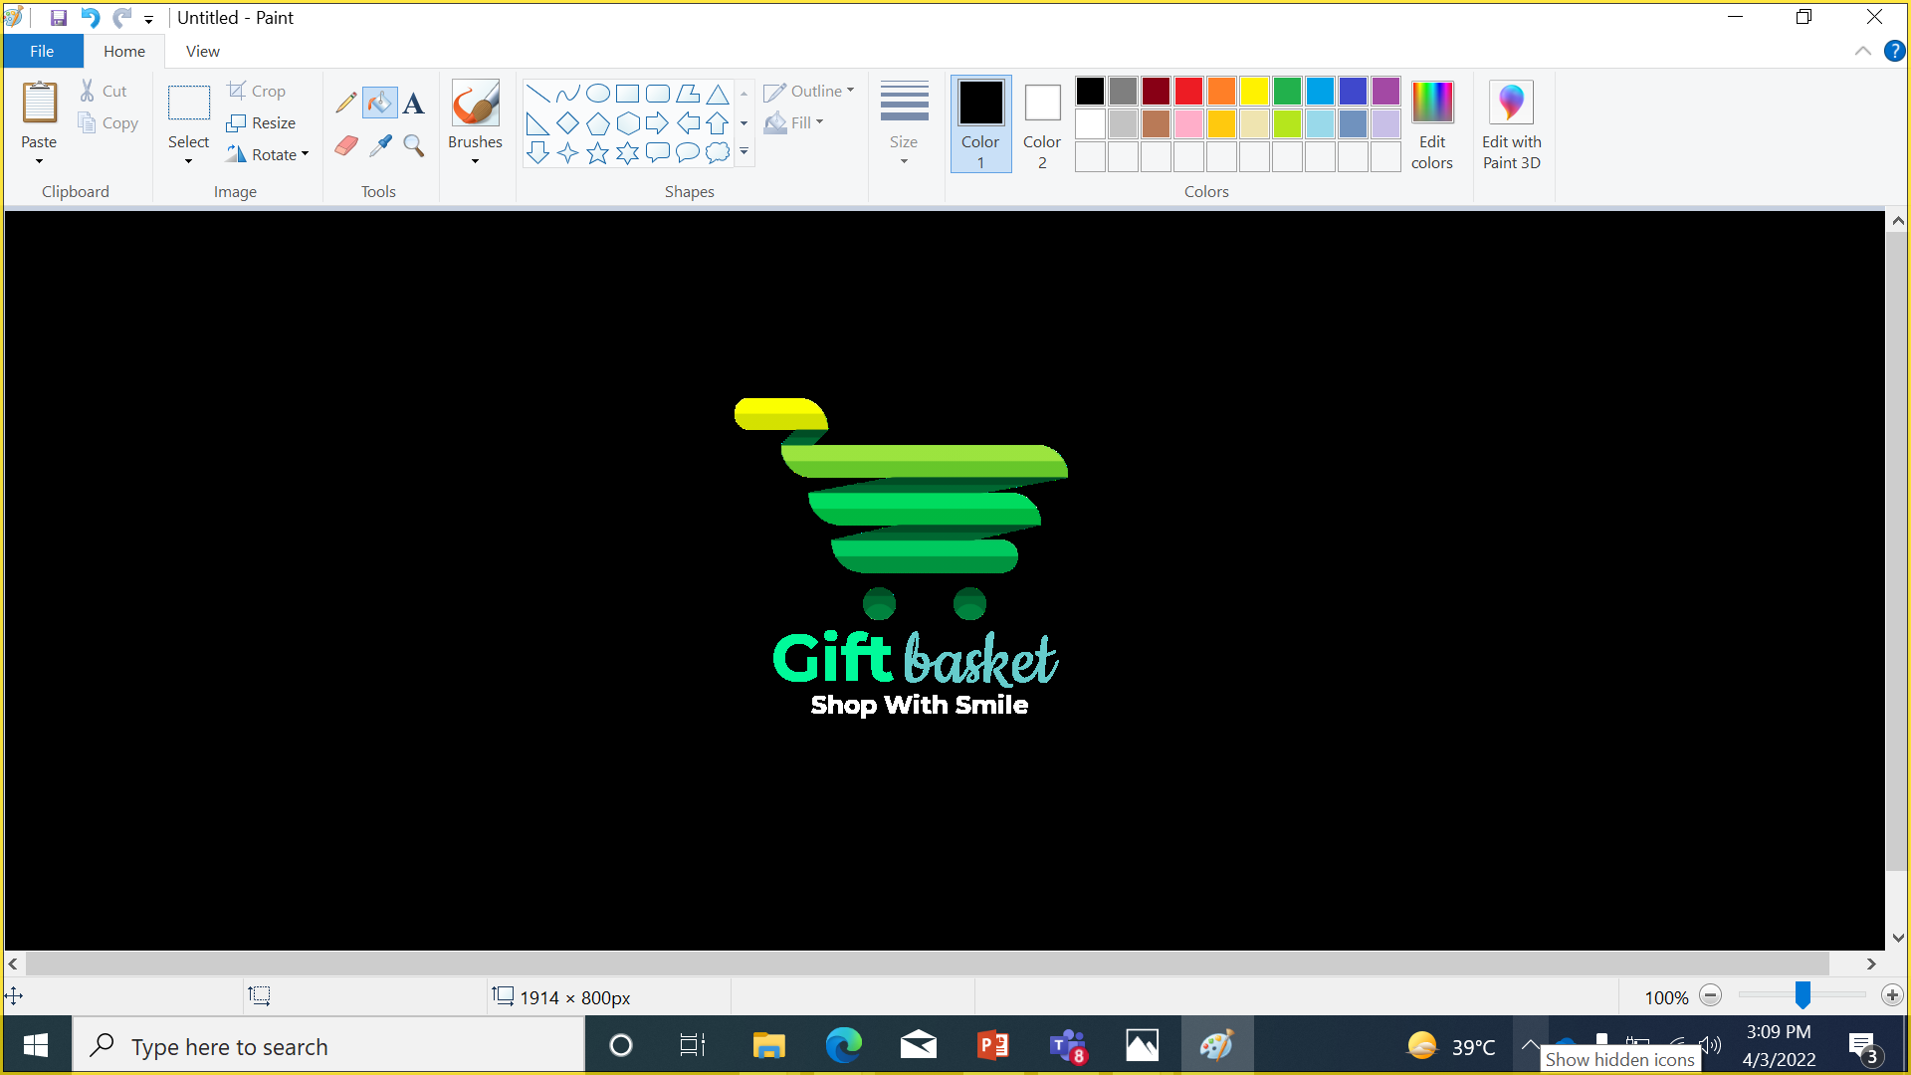
INTRODUCTION
Gift Basket is an online Digital Gift Superstore in India. At Gift basket we provide different customizable gift items for your loved ones. At Gift Basket, anyone can easily customized any Mobile phone Cases, Mugs, T-Shirts, Photo Canvas, Posters, Playing Cards, Badges, Visiting Cards and More gifting items Online within minutes.
The website is designed for the users to help them out to find items which will make them stand out in the crowd with Personalized and Unique products printed specially by them. The Website is very user-friendly and the flow of ordering items is very easy to use. It is an idea derived from the product selling concept of our very own team member K ABHIRAM online store of selling customizable items . We planned to make the items reach at the national level. So, here we (TEAM MAJESTY) present to you our website … GIFT BASKET….
Link for the website : https://abhiramprints.github.io/gift_basket/

Slide 4

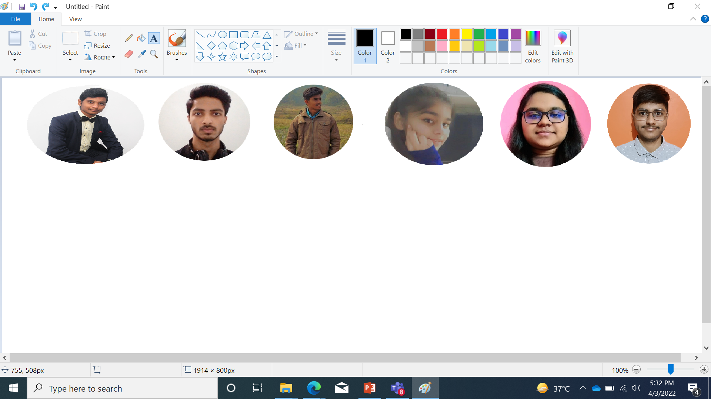
TEAM MAJESTY
Our team consists of six members who have worked really very hard to make this project successful.
Every member plays a significant role in the completion of this project. The member of the group are : K ABHIRAM, TUSHAR PRABHAKAR, ROHIT KUMAR RAY, SHRASTI ARYA, T. SAISHREE & AYUSH VERMA.

Slide 5
HOMEPAGE
NAVIGATION BAR
ABOUT
CATEGORIES
FEEDBACK
CONTACT US
CATEGORIES AVAILABLE
MDF GIFTS
STATIONARY GIFTS
CUSTOMIZED WEARABLES
CUBICLE ESSENTIALS
GET IN TOUCH FORM
ENTER NAME, EMAIL AND MESSAGE
SEND MESSAGE
FIND US HERE
ONLINE STORE ADDRESS
FOOTER
QUICK LINKS
CONTACT DETAILS

Slide 6
PRODUCT CATALOG
Our Website currently have product catalog for four categories mainly : MDF GIFTS STATIONARY GIFTS CUSTOMIZED WEARABLES and CUBICLE ESSENTIALS .
Currently every category is serving with four items . The product catalog pages for every category is made using HTML & CSS layout. The product catalog page also have an in-build buying option which will directly redirect to the billing area.

Slide 7

WHAT WE SELL !!!
MDF GIFTS
WOOD ENGRAVED FRAMES.
JIGSAW PUZZLE FRAME
LED PHOTO FRAME
PHOTO CANVAS
STATIONARY GIFTS
LETTER HEADS
NOTEPAD
CUSTOMIZED DIARIES
PERSONALISED HOLDER
CUBICLE ESSENTIALS
PEN STAND
SIPPERS
SMART TIFFIN BOX
SMART BELT
CUSTOMIZED WEARABLES
T – SHIRTS
HOODIES
CAPS
MASKS

Slide 8

HOW TO BUY A PRODUCT
OPEN WEBSITE
CLICK ON CATEGORIES
SELECT THE KNOW MORE OF THE CATEGORY YOU WANT TO BUY
CLICK ON KNOW MORE OF THE ITEM YOU WANT TO BUY
SELECT DESIGNS, SHAPES, SIZES and QUANTITY AVAILABLE AND CLICK ON BUY NOW
ENTER NAME, E-MAIL, PHONE NUMBER AND ADRESS THEN COMPLETE THE ONLINE PAYMENT
YOUR PAYMENT IS DONE SUCCESSFULLY AND ORDER IS PLACED

Slide 9

other Features
LIVE TIME AND DATE STAMP
We are very conscious about the time of our customer, so we have a live time and date stamp which would help the customers know the current time and help them to manage their time on website.
Every customer satisfaction is important and so do their feedback. We have a feedback form so that the customer would share their buying experience.
ALL ONLINE PAYMENT METHODS
We provide with all online payment methods like : Card payment, UPI and Net banking. These methods are used using Payment redirect website : INSTAMOJO..
FEEDBACK FORM

Slide 10
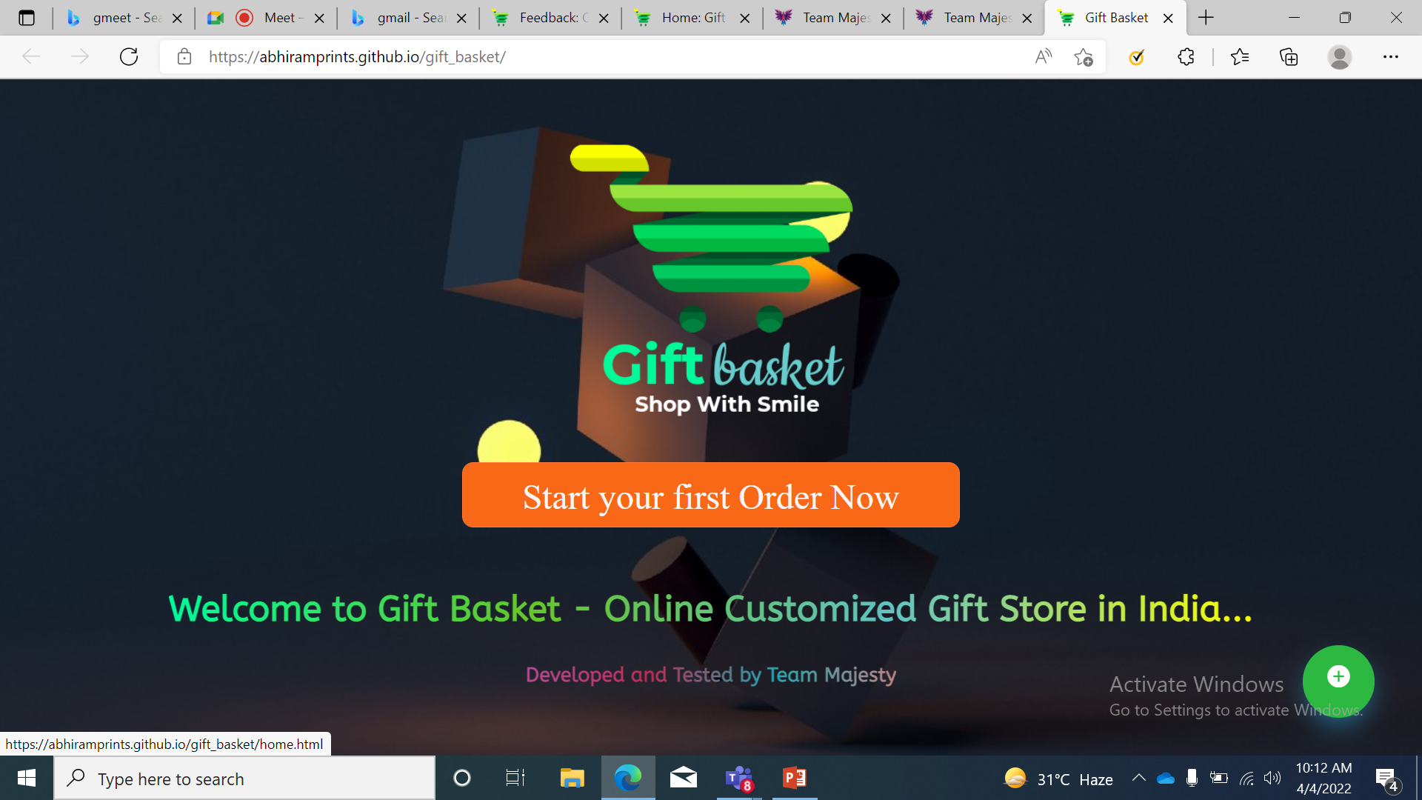
WELCOME PAGE

Slide 11
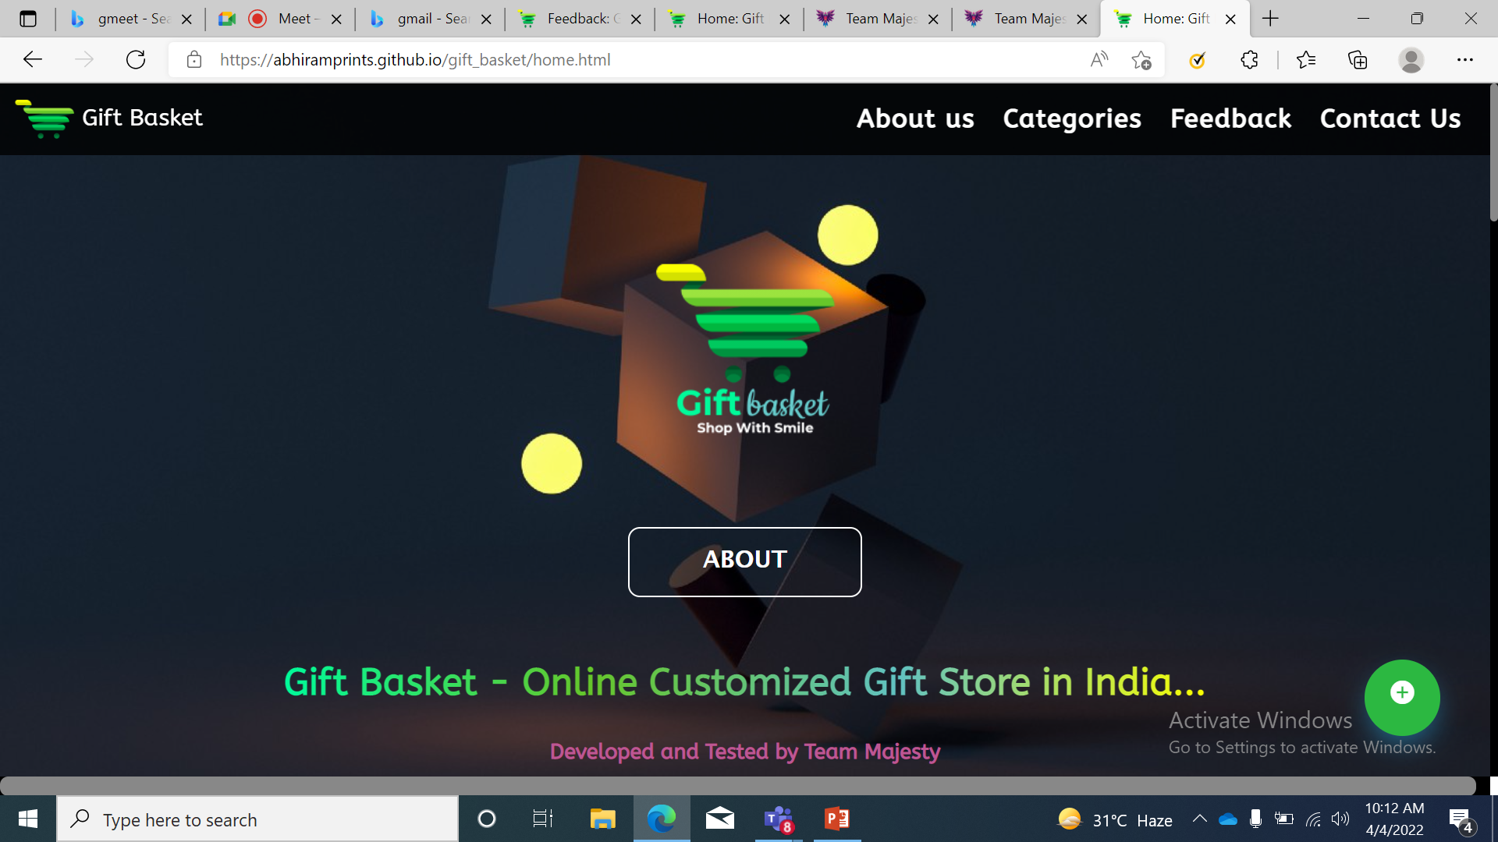
HOMEPAGE

Slide 12
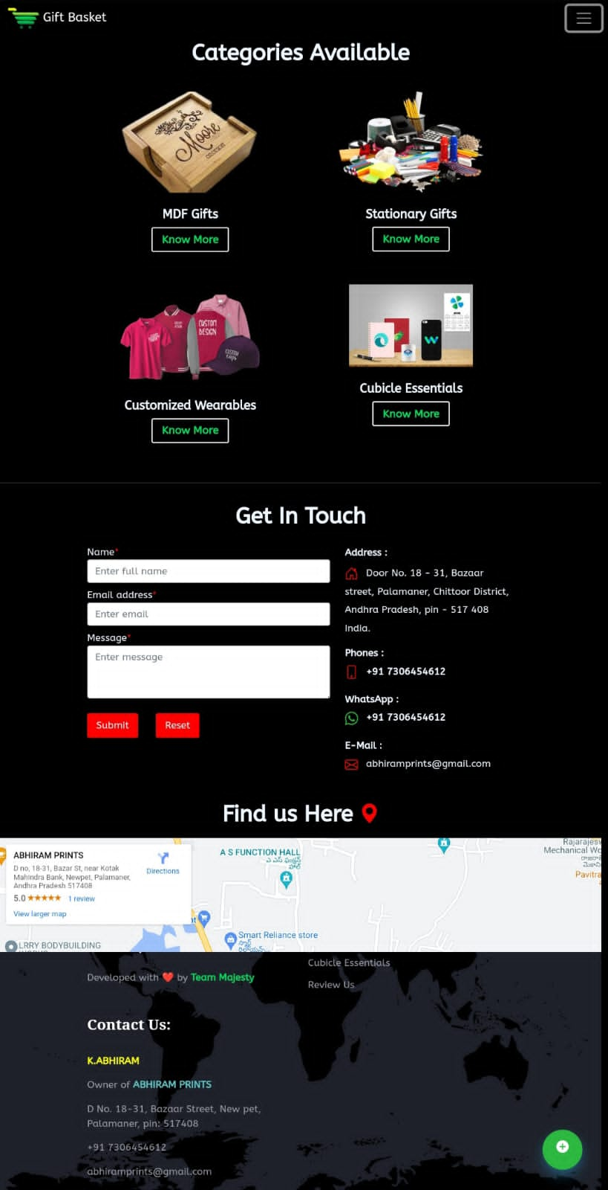
CATEGORIES AVAILABLE

Slide 13
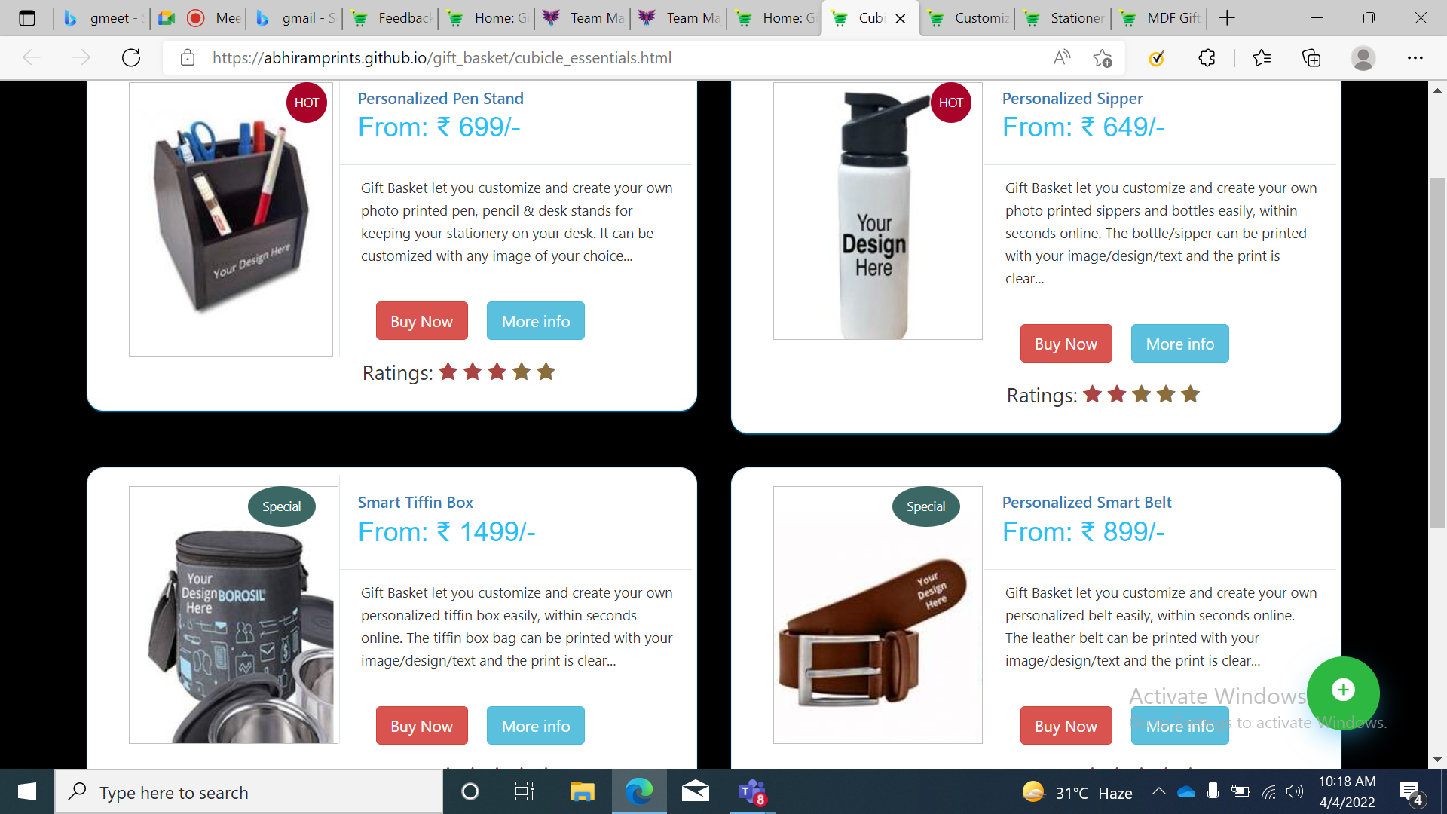
PRODUCT CATALOG PAGE

Slide 14
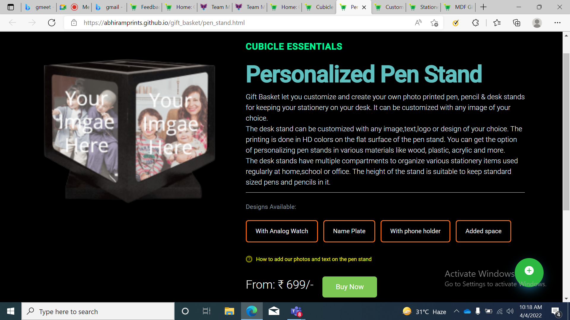
A product detailed view page

Slide 15
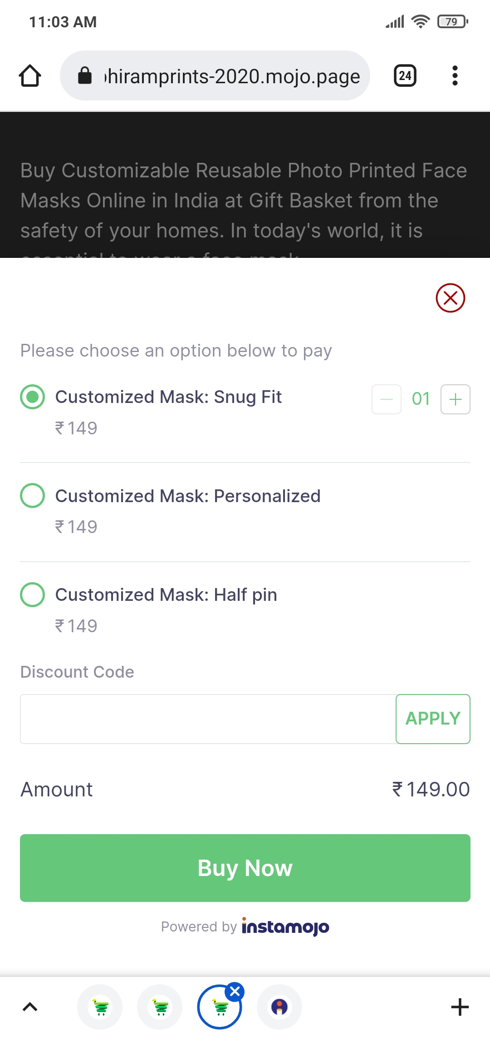
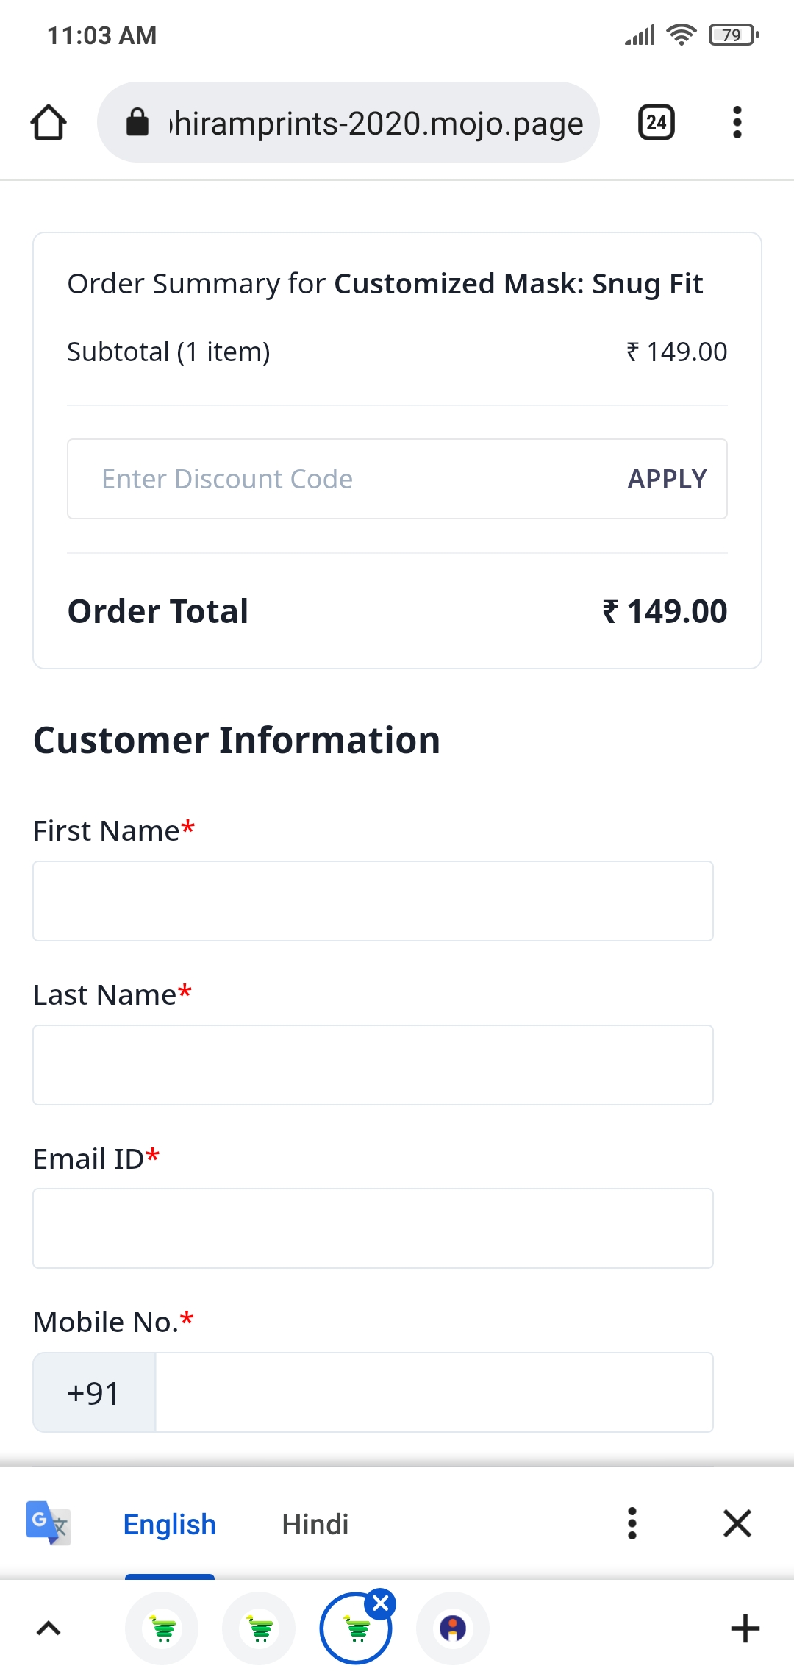
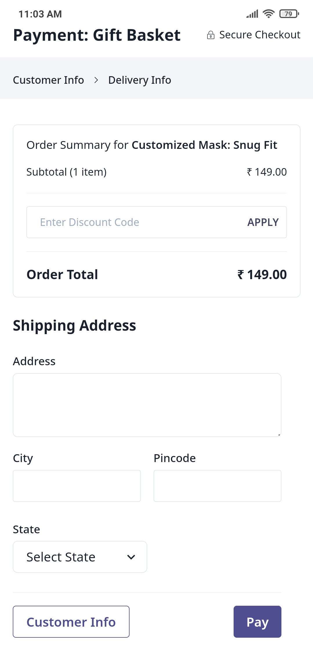
BUYING AND ENTERING DETAILS

Slide 16
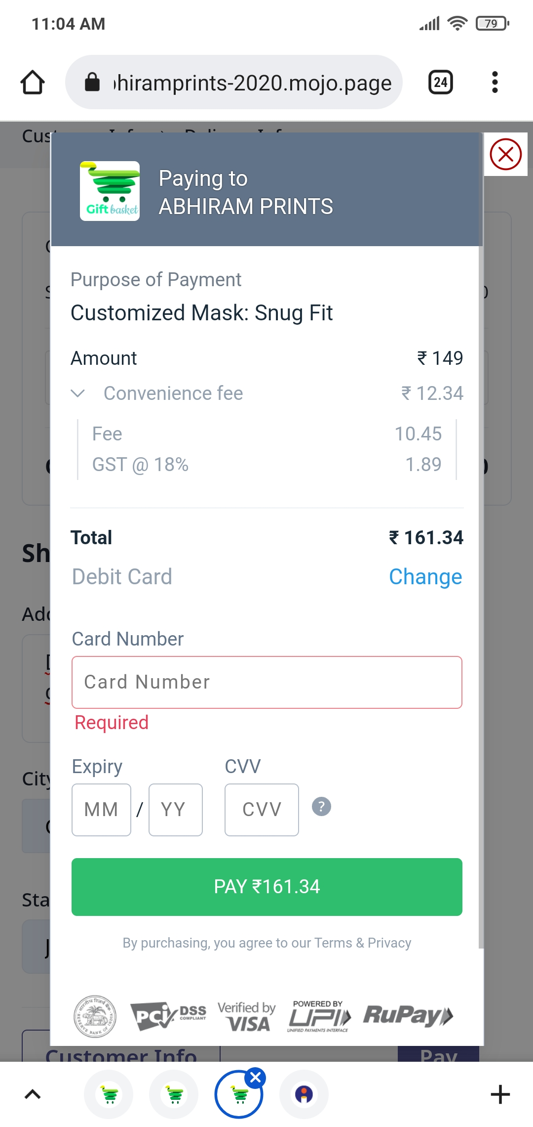
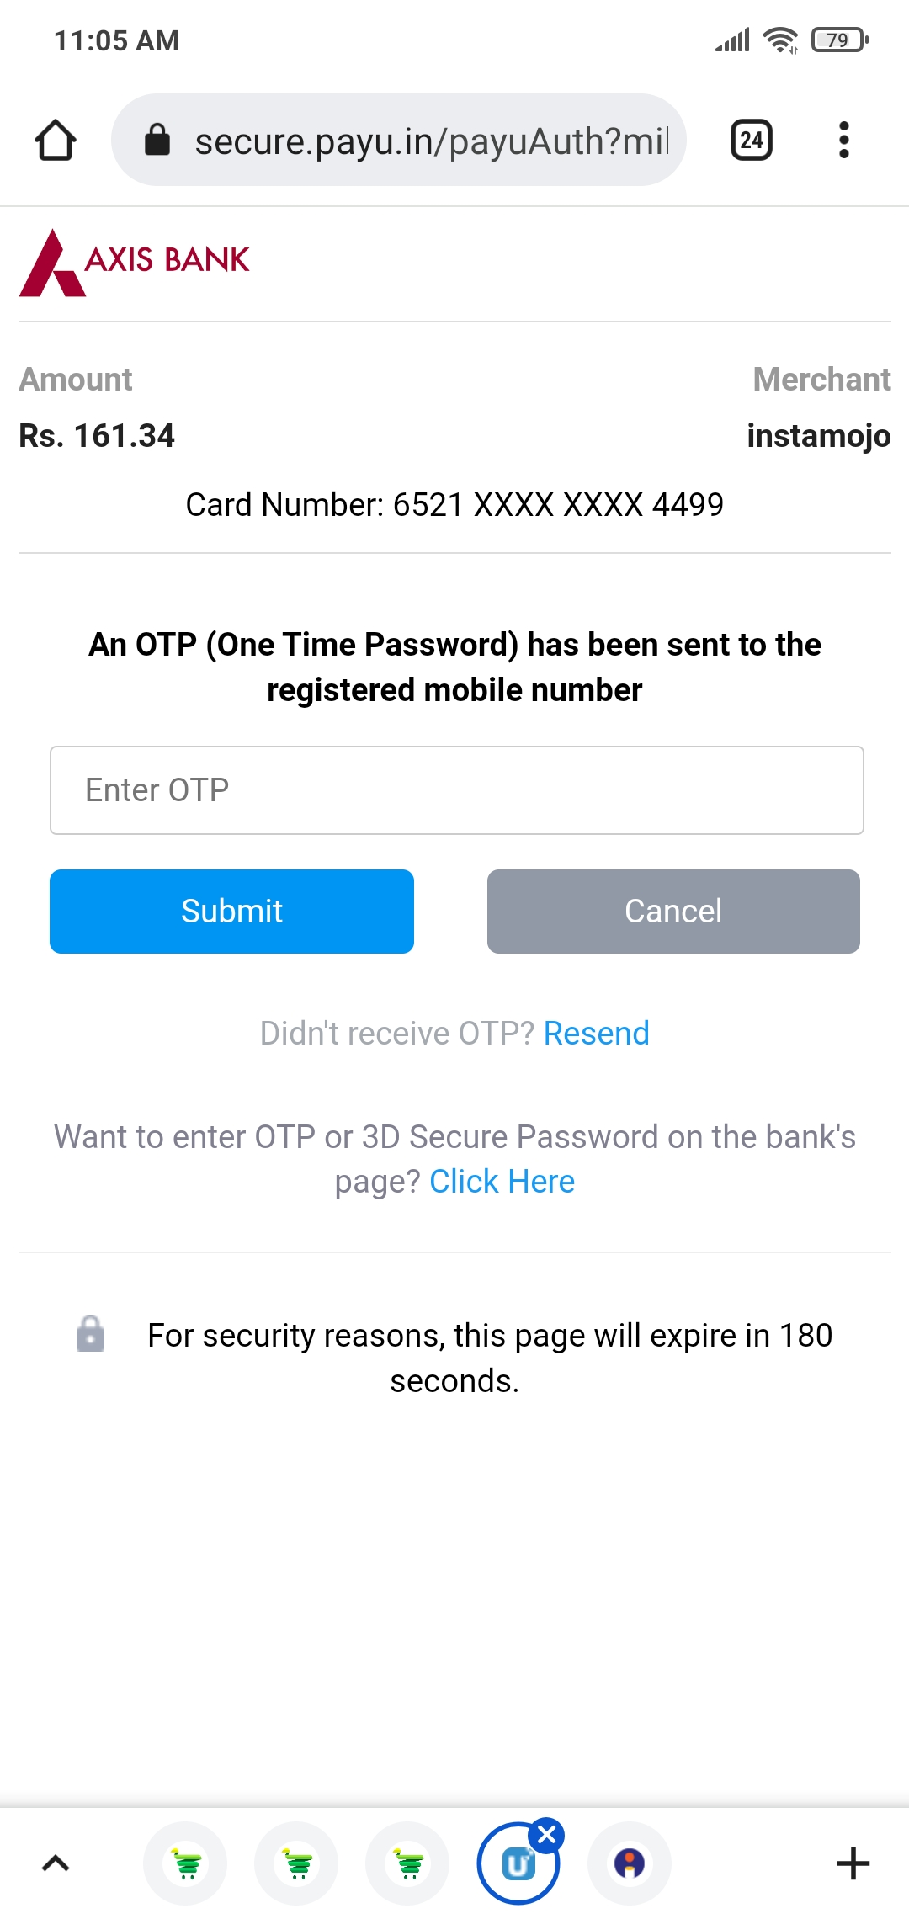
PAYMENT PAGES

Slide 17
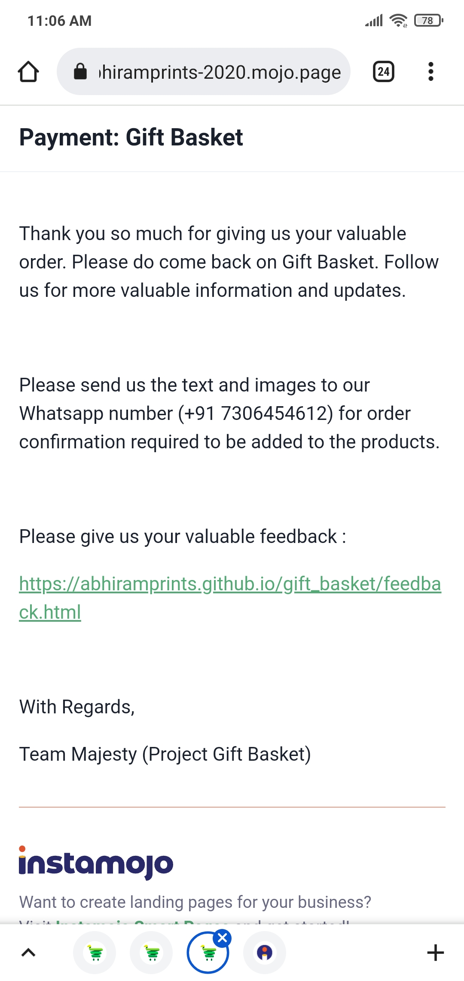
PAYMENT COFIRMATION

Slide 18


